Slide 1
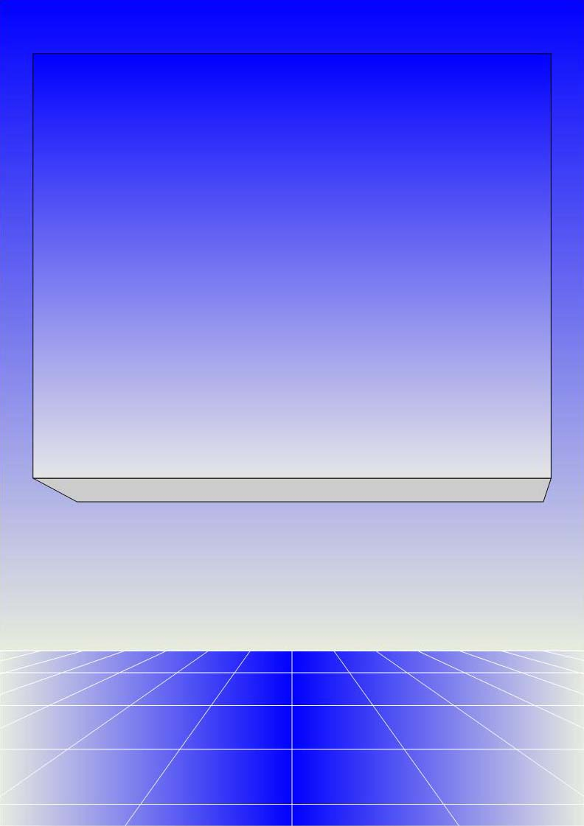
CO2301 - Games Development 1
Week 2
Game Agents
Gareth Bellaby

Slide 2

Introduction

Slide 3
AI systems
Two ways to think about implementing AI in a game:
Abstract controller, e.g. routines.
Game Agent, e.g. something situated within, and interacting with, the game world.
These are not mutually exclusive. These are alternatives.

Slide 4
Abstract Controllers

Slide 5
Abstract Controller
Abstract controller. An example of this approach would be a decision making module which sits outside the game world.
For example a strategy game (real-time or turn-based) would typically be implemented using a controller. The controller uses routines in order to make decisions.
The controller is abstract because it is not an agent within the game world. It reasons using abstractions of the game data.

Slide 6
Abstract Controller
For example, production rules.
IF no fishing boats
AND access to water
AND wood stores exceed 10 units of wood
THEN build fishing boat
Example here is from a game such as Civilization or Age of Empires.
Return to production rules and some other "routine" based approaches next year.

Slide 7
Two approaches
Abstract controller (routines).
Game agent. A character in the game world. Autonomous or semi-autonomous. Uses a biological structure. Something more akin to a human player, indeed it is the approach used when we want to mimic a human player, e.g. in an FPS.
Many of the techniques are used with both approaches, e.g. pathfinding. A game agent in a FPS would employ pathfinding to move to the player. A unit in a RTS would employ pathfinding to move to a resource.
The boundaries are flexible. The two approaches can overlap, e.g. in group AI.

Slide 8
Game Agents

Slide 9
Agent (Actor)
Common phrase in the AI literature is "Intelligent Agent". Sometimes you'll read "Software Agent".
In games I've come across both "Game Agent" and "Game Actor".
I'll stick with the phrase "Game Agent".
Agents bring together AI representation and routines, physical representation, graphical representation.
One typical goal within game development is the production of an intelligent agent.

Slide 10
Definition of an Intelligent Agent
  "An agent is anything that can be viewed as perceiving its environment through sensors and acting upon that environment through actuators."
  Russell & Norvig, Artificial Intelligence, (2nd ed.)
You'll find a lot of material about Agents within the AI literature.
Chapter 2 of Russell & Norvig is a good place to start. The whole book can be said to be informed by the intelligent agent approach within AI. It has informed much of the discussion in this lecture.

Slide 11
Intelligent Agents
Agent Type | Performance Measure (goal) | Environment | Actuators | Sensors
Medical diagnosis system | Healthy patient, minimise costs | Patient, hospital, staff | Questions, tests, diagnoses, treatments, referrals | Keyboard entry of symptoms, findings, patient's answers
Refinery controller | Maximise purity, yield safety | Refinery operators | Valves, pumps, heaters, displays | Temperature, pressure, chemical sensors
Interactive English tutor | Maximise student's test score | Students, testing agency | Exercises, suggestions, corrections | Keyboard entry
Russell & Norvig, Artificial Intelligence, (2nd ed.)

Slide 12
Racing driver agent
Agent Type | Performance Measure (goal) | Environment | Actuators | Sensors
racing driver | safe, fast, minimise tire-wear, brake-wear and fuel | track, other cars, weather | steering, accelerator, brake, gear change | vision, mirror, speedometer, rev. counter, lap counter

Slide 13
Basic Game Agent loop
think
sense
act

Slide 14
Game Agent with Memory
think
sense
act
memory

Slide 15
Software Agents
Rational action depends on...
A performance measure of success, i.e. numerical data.
The agent's perceptual history. The agent's memory.
What the agent knows about the environment.
The actions the agent can perform.
Agent = architecture + program

Slide 16
Some Characteristics
Agents are "situated". An agent exists in a world. An agent is sensitive to its environment (sensitive == "it senses"). An agent is not omniscient. It does not have total knowledge of its world.
Agents are "interactional". Agents interact with the world. Agents interact with each other. In this sense, agents can be seen to be "social". The use of game agents can give rise to emergent behaviour.

Slide 17
Some Characteristics
Agents are "autonomous". Autonomy = "self-governing"
  If the agent's actions are entirely based on built-in knowledge then it lacks autonomy.
  One goal is autonomous or semi-autonomous agents.
Agents are "flexible". An agent responds to its environment. An agent can have goals and desired states.

Slide 18
Some types of Agent
Reflex agents respond immediately to percepts. For example, if the car in front is braking then hit own brakes. (Percept: "the representation of what is perceived".)
Goal-based agents act to achieve their goals (including searching and planning). For example, reach the target location.
Utility-based agents try to maximise their own "happiness" (if one world state is preferred to another then it has a higher utility). For example, being in front in a race is a preferred state.

